Slide 1
Athitektura EBSI mreže
EBSI-NE project demistification workshop
Zorislav šojat
Institut ruđer bošković

Slide 2
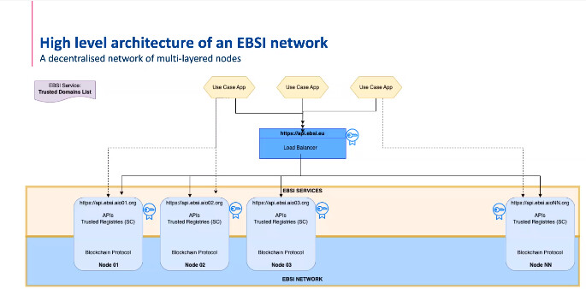

Slide 3
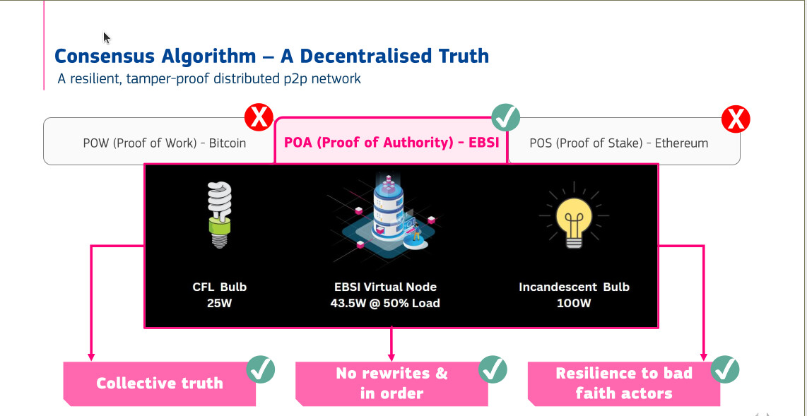

Slide 4
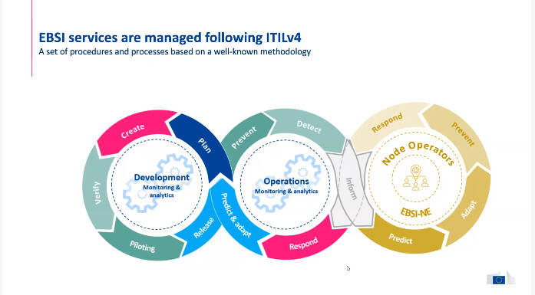

Slide 5
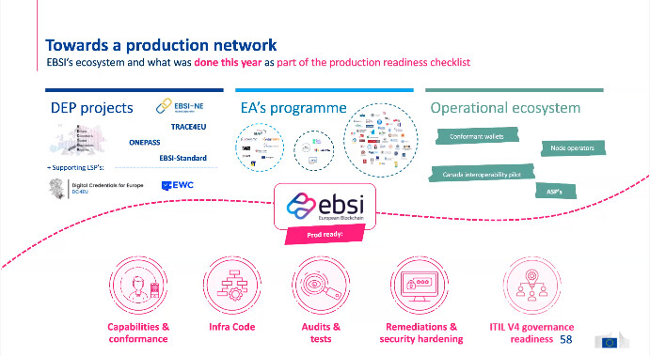

Slide 6
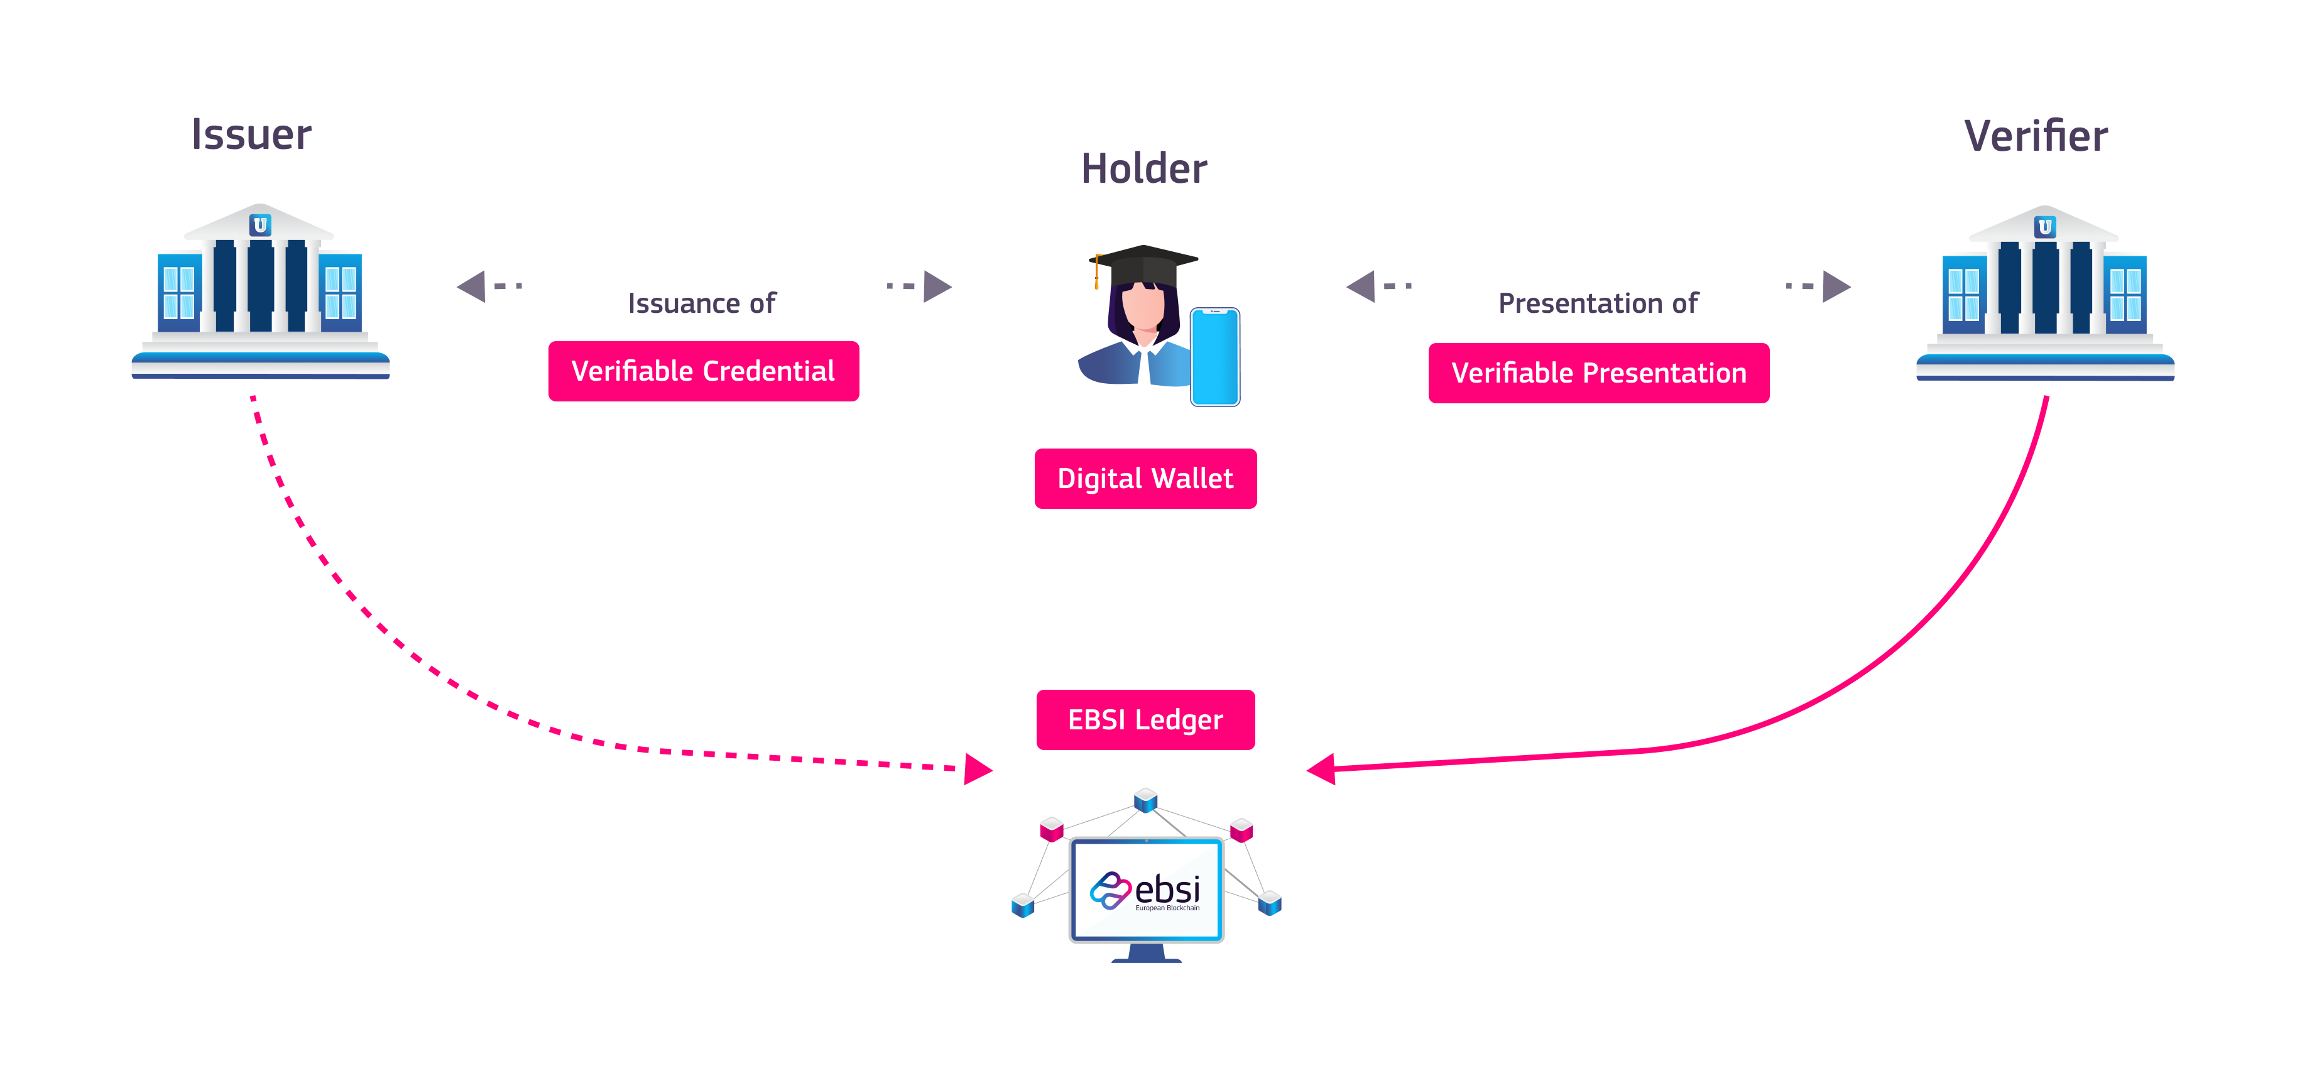

Slide 7
