Slide 1
ROUND TABLE DISCUSSION
ROLE OF CROATIA IN THE FIELD OF BIOTECHNOLOGY
Prof. emer. Zlatko Kniewald Ph.D.
Croatian Academy of Engineering
May 25, 2017.
Hall – C
13.30 – 15.00

Slide 2
Important institutions for R&D in Biotechnology
in cooperation with industry
1956 U. of Zagreb, Faculty of Technology, Study of Biotechnology
1981 U. of Zagreb, Faculty of Food Technology and Biotechnology
1992 Croatian Society of Biotechnology
1992 Scientific Council for Agriculture and Forestry of the Croatian
Academy of Sciences and Arts
1993 Croatian Academy of Engineering, Department of Bioprocess
Engineering and Biotechnical Center of the Academy
1996 Biotechnical Foundation

Slide 3
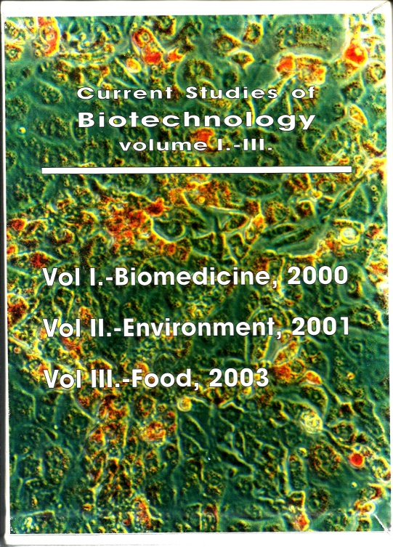
Biotechnology in Croatia
Current Studies of Biotechnology I-V
2000 Biotechnology and Biomedicine
2001 Biotechnology and Environment
2003 Biotechnology and Food
2005 Biotechnology and
Immuno-Modulatory Drugs
2007 Biotechnology, Energy, Chemicals
and Renewable Raw Materials

Slide 4
Strategical investments in the fields
of application of biotechnology in Croatia
Primary and secondary food and beverages production – green biotechnology,
Health care and pharmaceutical industry – red biotechnology,
Biotechnology of water resources, marine biotechnology and environmental protection – blue biotechnology
Production of industrial raw materials, chemicals,
materials and fuels – white biotechnology

Slide 5
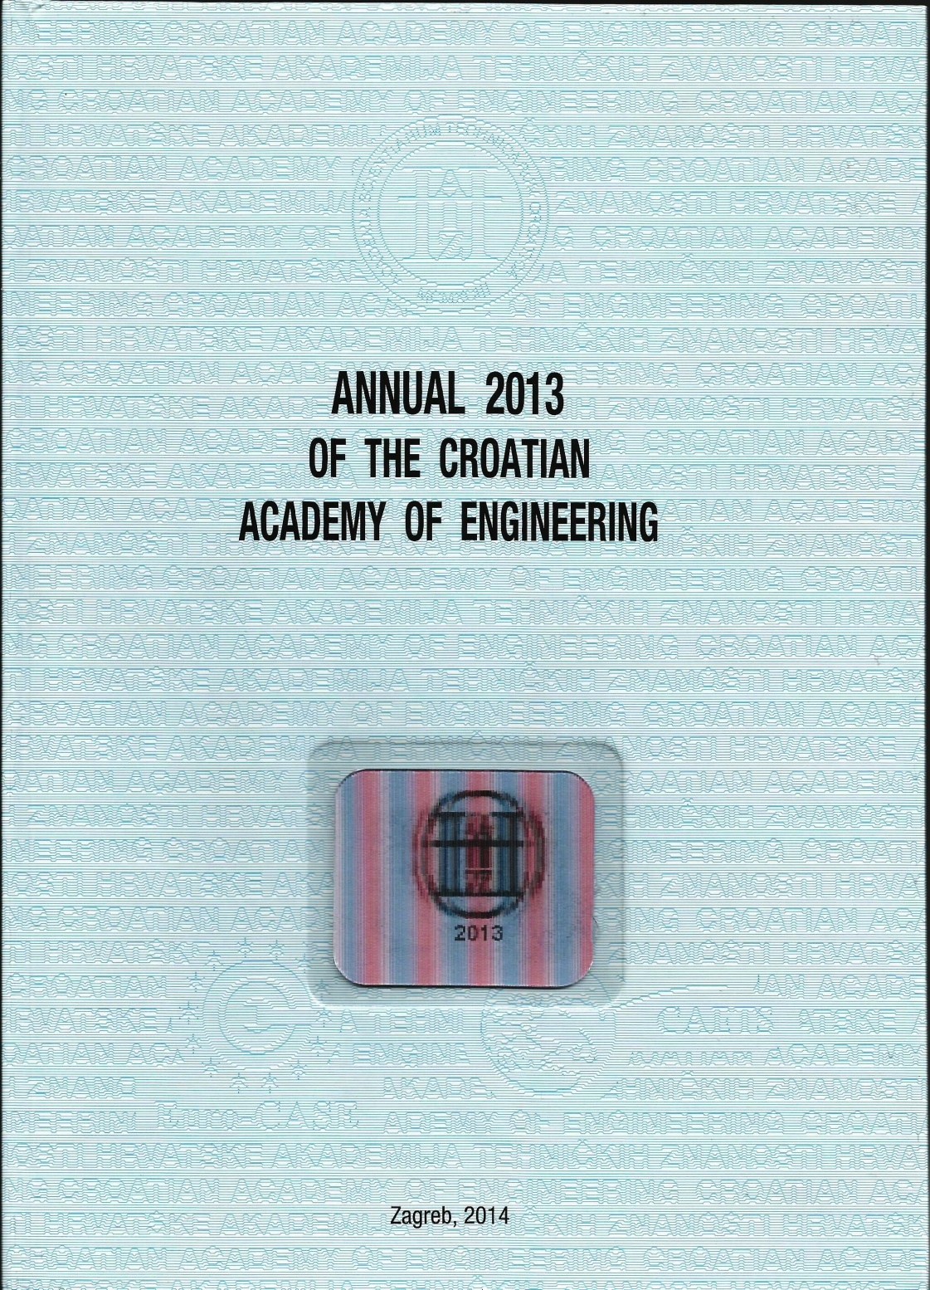
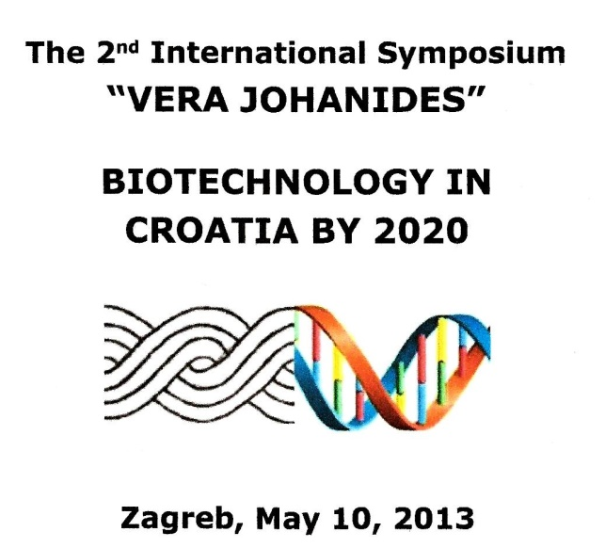
ISSN 1332-1482
385 pages
Publ. Croatian Academy
of Engineering

Slide 6
The 2nd International Symposium „Vera Johanides”
BIOTECHNOLOGY IN CROATIA BY 2020
Zagreb, May 10 – 11, 2013
Symposium was directed to:
Strategical directions of the development of Croatia by 2020,
Economy,
Bioinnovation cores and technological centers,
Bioscience and higher education.

Slide 7
Sellected participants

Slide 8
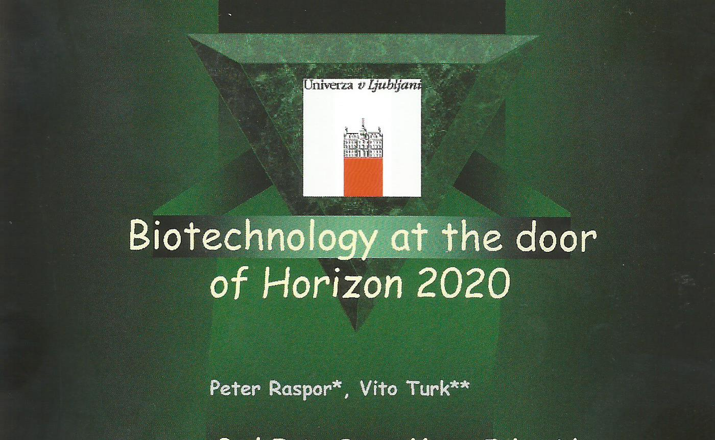
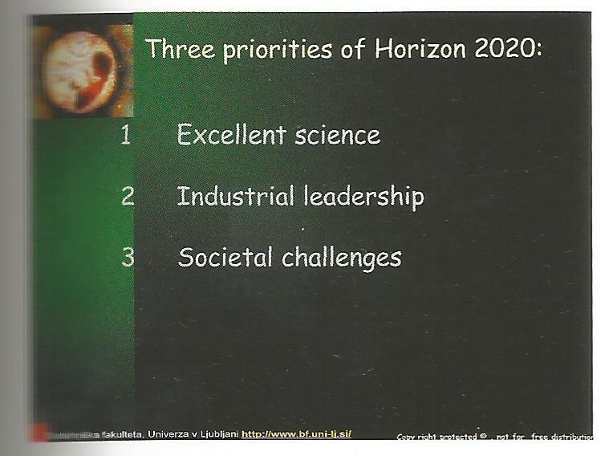


Slide 9
Higher Education for the Requirements of Industrial Production: European Experience and Croatian Challenges
Vladimir Mrša
Study curricula
Higher-education resources
Quality assurance in higher education

Slide 10
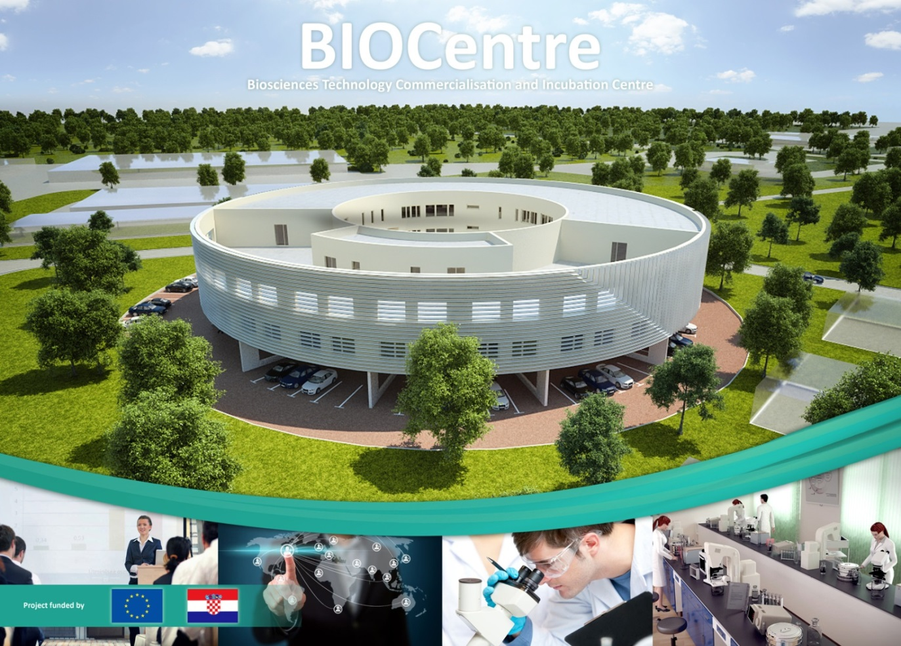
BIOCentre: The Bioscience Technology Commercialization and Incubation Centre
In total, the BIOCentre has about 5,330 m² of gross floor area and about 4,457 m² of usable floor area.

Slide 11
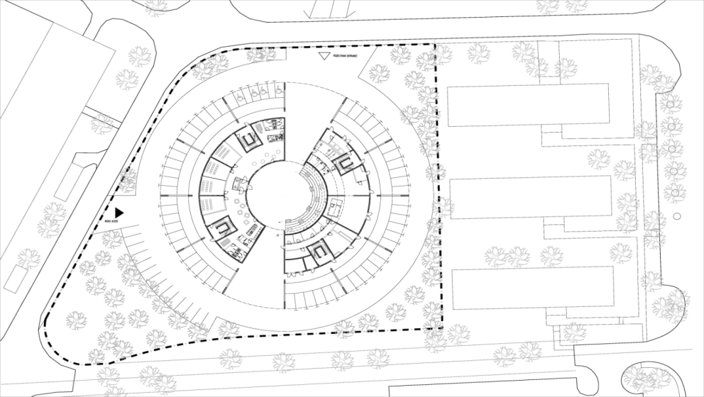
What is BIOCentre?
Where is it located?
What kind of support it offers?
To whom it offers support?
What is its target region?
Aleksander Bakowski¹*, Daslav Hranueli¹, Asier Fernández-Matamoros Olaizola¹, Dijana Kobas Dešković¹, Ivana Žorž², Gordan Leskovar², Srđan Novak³ and Ivo Friganović²
¹ ACE International consultants, Calle Sagunto 17 28010 Madrid, SPAIN
² BICRO Business Innovation Croatian Agency, Planinska 1, 10000 Zagreb, CROATIA
³ Centre for research, development and TT, University of Zagreb, Zvonimirova 8, 10000 Zagreb, CROATIA

Slide 12
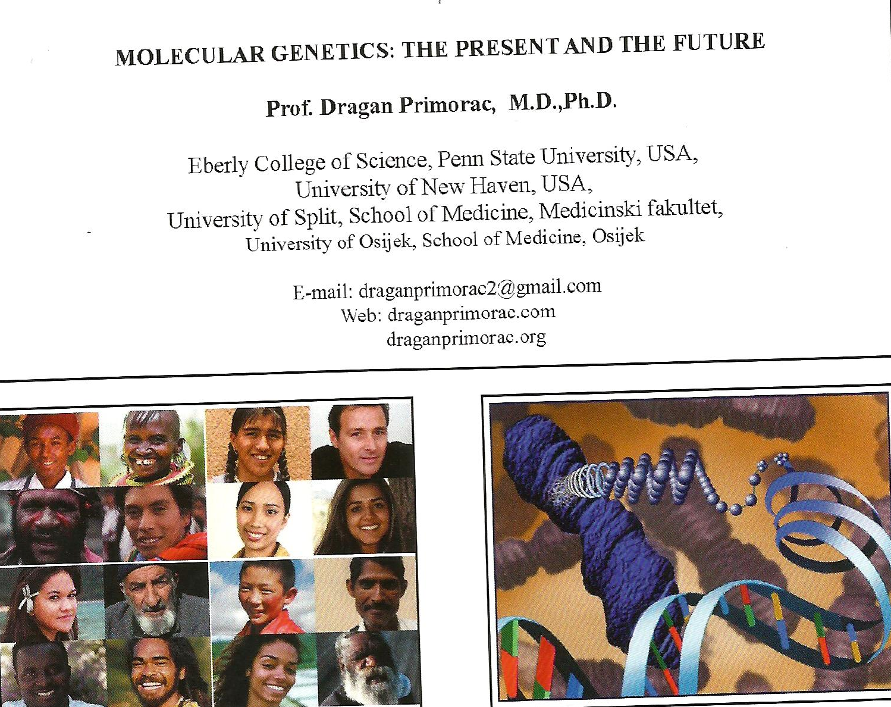

Slide 13
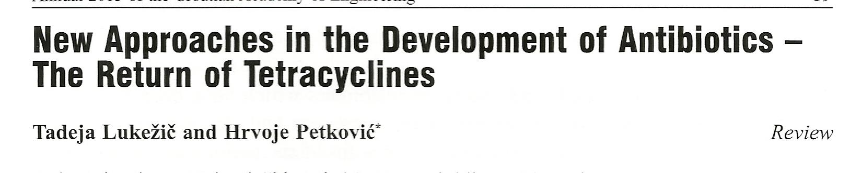
Typical and atypical tetracycline's
Biosynthesis of tetracycline's
Proposed biosynthetic pathway of chelocardin
Prospects for new tetracycline antibiotics

Slide 14
Mathematical Modelling of Virus
Replication Kinetics as a Function of Biological Reaction System Properties
Marijan Bošnjak¹*, Daslav Hranueli² , Jo Maertens³ , Davor Valinger² , Želimir Kurtanjek² and Erick J. Vandamme³
¹ Croatian Academy of Engineering, Kačićeva 28, 10000 Zagreb, Croatia
² Faculty of Food Technology and Biotechnology, University of Zagreb, Pierotti St. 6, 10000 Zagreb, Croatia
³ Faculty of Bioscience Engineering, Ghent University, Coupure Links 653, 9000 Gent, Belgium

Slide 15
Application of High Power Ultrasound
in Inactivation of Microorganisms
Zoran Herceg* , Anet Režek Jambrak and Vesna Lelas
Thermosonification
Manosonification
Manothermosonification

Slide 16
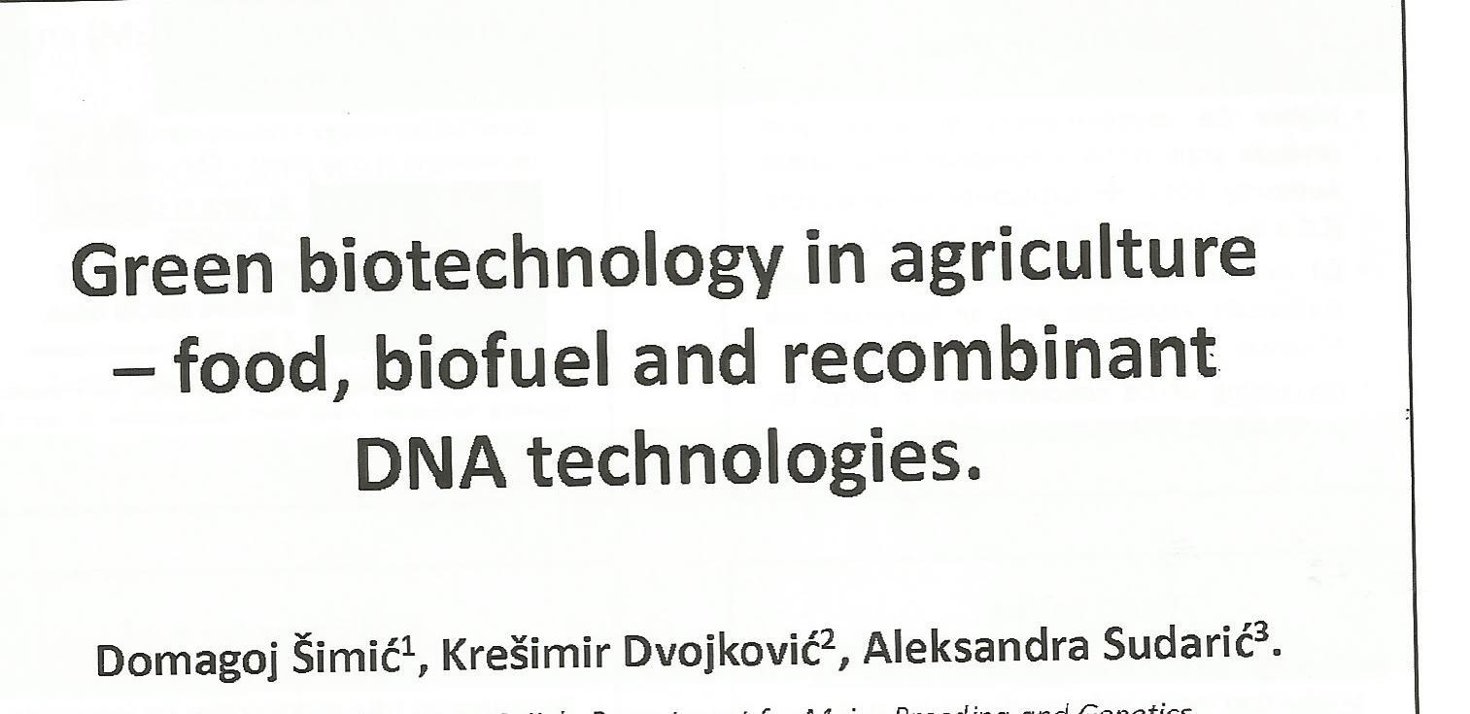


Slide 17
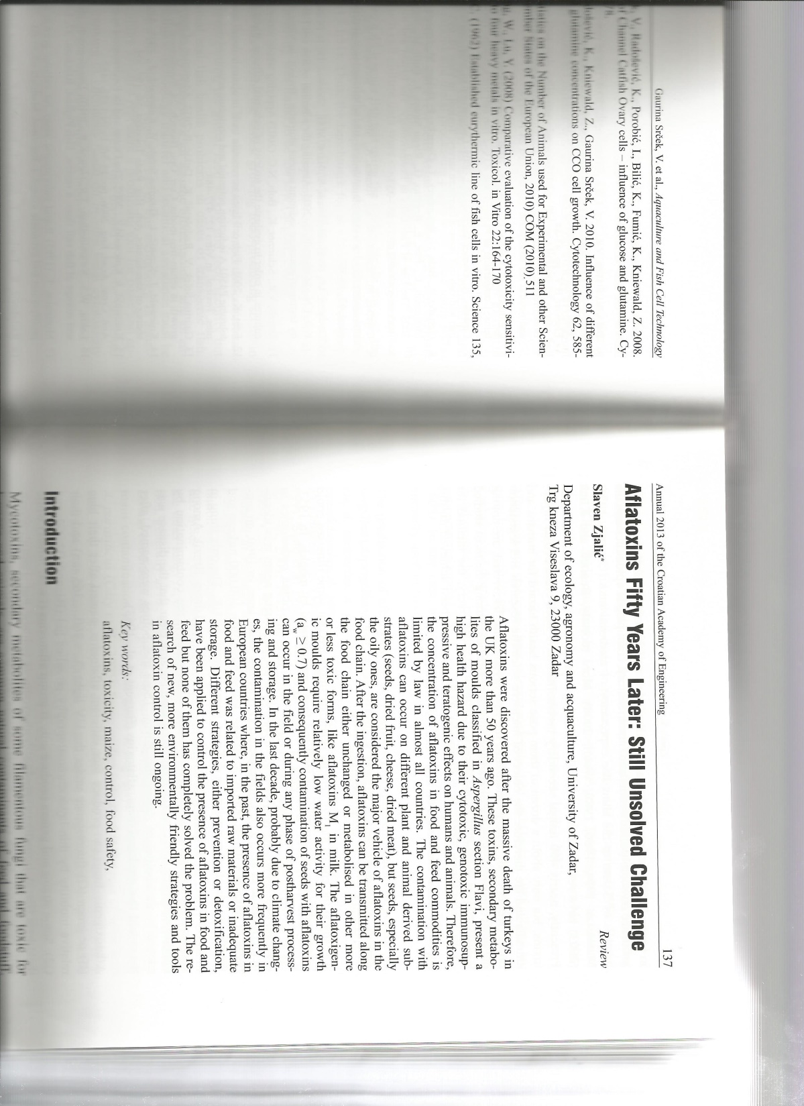
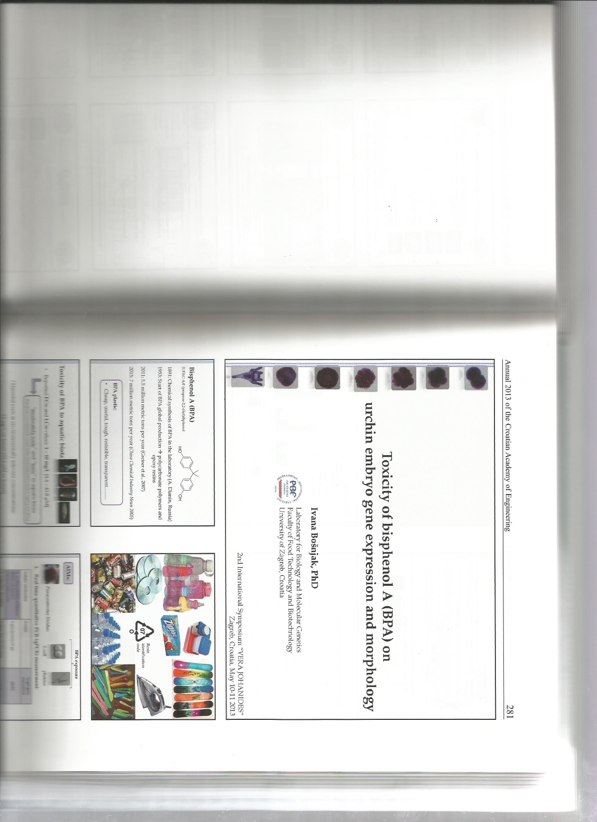

Slide 18
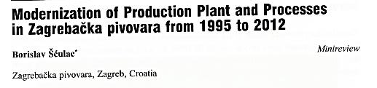
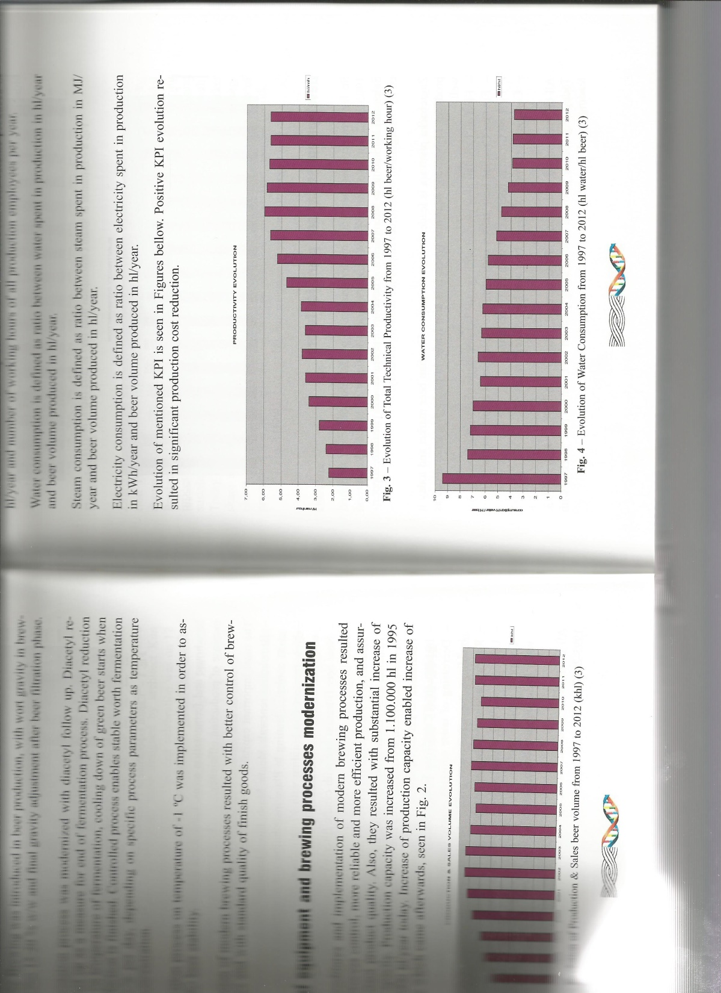

Slide 19
